Slide 1
Whitworth University
CS 374
Database Project
‘MUSIC DATABASE’

Slide 2
Database Management CS 374
Professor
Dr. Peter Tucker

Slide 3
Rubella
German measles or three-day measles
Prepared and developed
Larissa Brewer and Ahmed Raoof

Slide 4
Motivator:
As students of Whitworth University, and part of DB class 374, we are required to develop present a database project. Our database project entitled ’Music Database’its aim is to formally describe the phases of the design and development which are categorized into 3 main steps: Database, Application and Graphic User Interface. The platform is a SQL database with C++ code interface. The result is a database which enables the user and to manage the information of artists, albums and songs..

Slide 5
Objective:
Provide follow students with class relative information about the development of a sample centralized relational Music Database application and how this application could be used to store information of artists with their products..

Slide 6
Agenda:
Welcome
Introduction
Related Research
Architecture
Functionality Design
Implementation Approach
Conclusion

Slide 7
Welcome!!

Slide 8
Introduction
This project is about developing a sample of centralized relational Music database application. This application has to store information of artists with their products. In this context the functionality is to update, remove and insert records for the different entities. The Core functionality is:
Add, delete, and update information about the album, artists and songs.
Notes:
Three day measles: The rash due to rubella on a child's back is similar to that of measles but the rash is less intensely red.

Slide 9
ARCHITECTURE
The Entity Relationship Diagram describes the entities of Product, Artist, Track. Each entity has a primary key. A product (album) has the media type CD or Records and consists out of tracks (songs). The attributes of each entity are given with the primary keys. The relationships such as album and the related media tracks connect the entities in a structured and simple manner.
Notes:
Rubella virus: is the only member of the genus Rubivirus and belongs to the family of Togaviridae, whose members commonly have a genome of single-stranded RNA of positive polarity which is enclosed by an icosahedral capsid.
Genus: is a taxonomic rank used in the biological classification of living and fossil organisms in biology. In the hierarchy of biological classification, genus comes above species and below family.
Togaviridae: is a family of viruses. Humans, mammals, birds, and mosquitoes serve as natural hosts. There are currently 32 species in this family, divided among 2 genera. Diseases associated with this family include: Alphaviruses: arthritis, encephalitis; Rubiviruses: rubella.
Genome: is the genetic material of an organism. It consists of DNA or ( RNA in RNA viruses). The genome includes both the genes, (the coding regions), the noncoding DNA and the genomes of the mitochondria and chloroplasts.

Slide 10
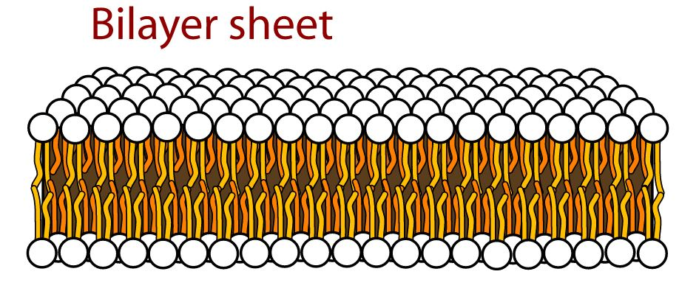
”
Interesting characteristic
It is a virus that belongs to family togavirus.
It is an enveloped RNA virus with a single antigenic type, circular or oval in shape and 60nm in diameter.
The outer membrane is a lipid bilayer.
The virion is composed of a capsid core containing a single copy of genomic RNA.
Rubella virus likely enters cells via endocytosis.
It is relatively unstable and is inactivated with the use of lipid solvents, trypsin, formalin, low pH, heat, and amantadine
Acute Rubella can be identified by a positive viral culture for rubella.
Notes:
Virion: a complete virus particle that consists of an RNA or DNA core with a protein coat sometimes with external envelopes and that is the extracellular infective form of a virus (merriam-webster)
lipid bilayer: is a thin polar membrane made of two layers of lipid molecules. These membranes are flat sheets that form a continuous barrier around all cells.
Endocytosis : is a form of active transport in which a cell transports molecules (such as proteins) into the cell (endo- + cytosis) by engulfing them in an energy-using process.
Viral envelope: Some viruses (e.g. influenza and many animal viruses) have viral envelopes covering their protective protein capsids. The envelopes are typically derived from portions of the host cell membranes (phospholipids and proteins), but include some viral glycoproteins. They may help viruses avoid the host immune system. Glycoproteins on the surface of the envelope serve to identify and bind to receptor sites on the host's membrane. The viral envelope then fuses with the host's membrane, allowing the capsid and viral genome to enter and infect the host.

Slide 11
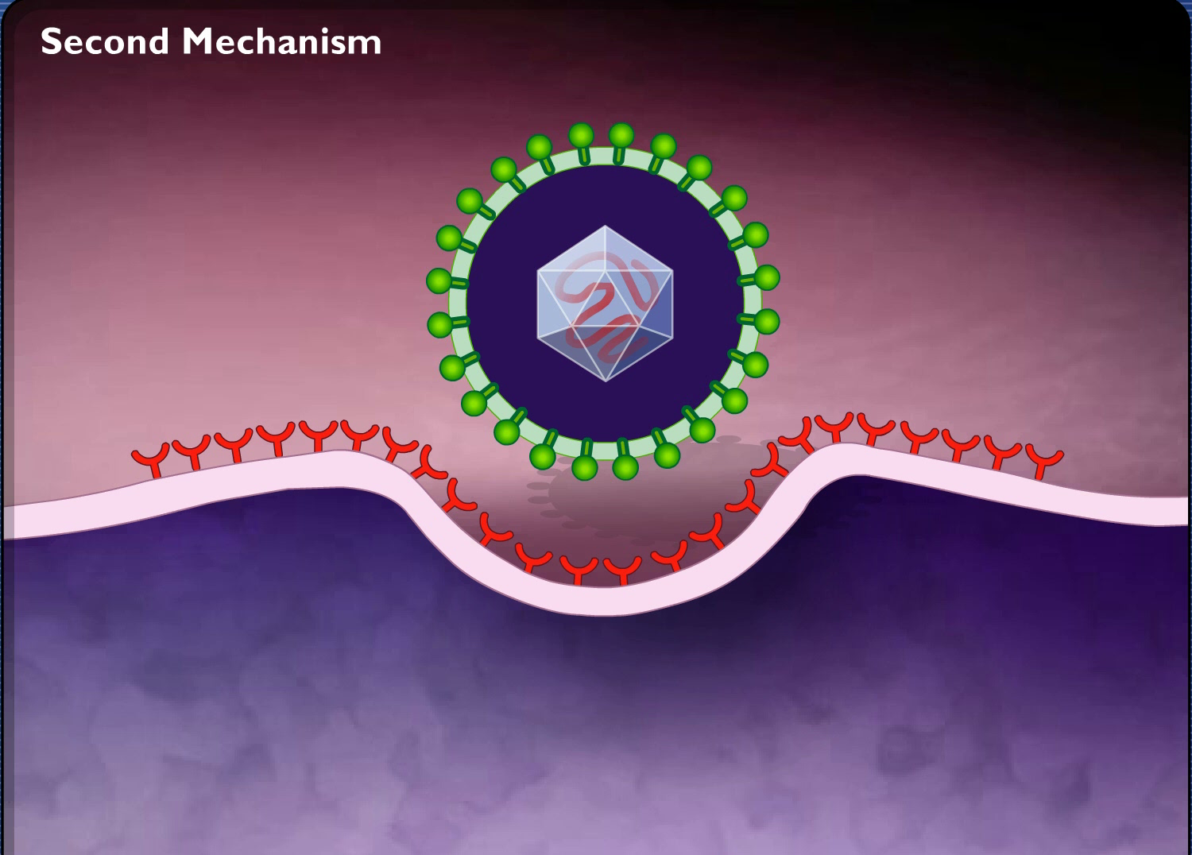

Slide 12
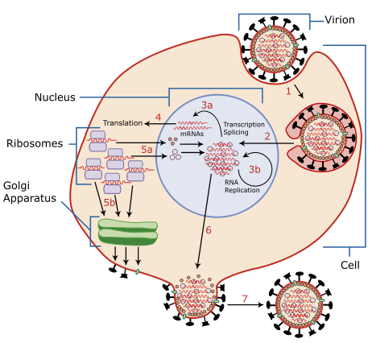
”
Endocytosis
Notes:
Endocytosis : It is a form of active transport in which a cell transports molecules (such as proteins) into the cell (endo- + cytosis) by engulfing them in an energy-using process.

Slide 13
”
Interesting catachrestic (Cont.)
It is a viral infection that affects unvaccinated children and young adults.
If unvaccinated woman gets rubella while pregnant especially in her first three months, there maybe serious consequences can result, including miscarriages, fetal deaths, still births, and having infants born with congenital rubella syndrome (CRS).
CRS is a group of devastating birth defects that includes blindness, deafness, and heart defects.
More than 100,000 children are born every year with CRS, mainly in Africa, South-East Asia, and the Western Pacific.
Notes:
CDC - Global Health - Global Immunization - Measles & Rubella (Facts and Statistics)

Slide 14
Environment
Rubella virus, can be found in the throat, blood, and stool of an infected person. The rubella virus multiplies in the lining of the respiratory tract or in local lymph nodes before passing into the bloodstream and spreading throughout the rest of the body. In pregnant women, the blood-borne virus may infect the placenta and replicate there. It can then spread to the fetal circulation.

Slide 15
Disease and symptoms
Rubella virus causes rubella infection. It is commonly known as German measles or 3-day measles.
A viremia occurs 5 to 7 days after exposure with spread of the virus throughout the body.
The incubation period of rubella is 14 days, with a range of 12 to 23 days.
Symptoms are often mild, and up to 50% of infections may be subclinical or in apparent.
In children, rash is usually the first manifestation and a prodrome is rare.
Notes:
Viremia : is a medical condition where viruses enter the bloodstream and hence have access to the rest of the body. It is similar to bacteremia, a condition where bacteria enter the bloodstream. The name comes from combining the word virus with the Greek word for blood (haima).
Prodrome is an early symptom (or set of symptoms) that might indicate the start of a disease before specific symptoms occur. It is derived from the Greek word prodromos, meaning "precursor".

Slide 16
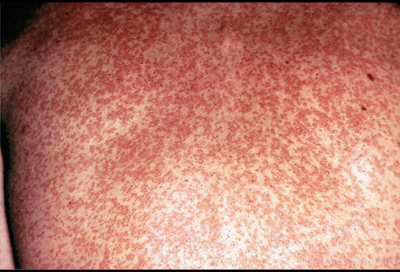
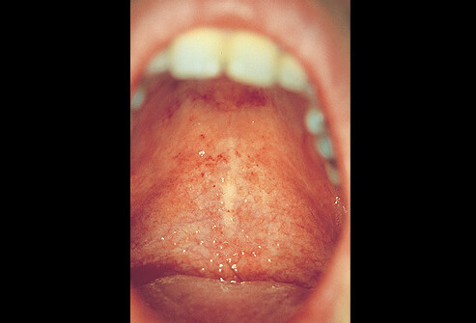
Rash
Forchheimer spots

Slide 17
Disease and symptoms (Cont.)
Older children and adults, there is often a 1 to 5 day prodrome with low-grade fever, malaise, lymphadenopathy, and upper respiratory symptoms preceding the rash.
The rash of rubella is maculopapular and occurs 14 to 17 days after exposure.
The rash is fainter than measles rash and does not coalesce.
Lymphadenopathy may begin a week before the rash and last several weeks.
Arthralgia and arthritis occur so frequently in adults
Other symptoms of rubella include conjunctivitis, testalgia, or orchitis. Forschheimer spots may be noted on the soft palate but.
Notes:
Maculopapular: Is derived from a fusion of two words, namely, ‘macules’ which is used to refer to small spots on the skin which are discolored and flattened in nature, and ‘papules’ which refers to small and raised bumps. Due to the abnormal redness of the skin due to capillary congestion that is a symptom of this disease
Coalesce: come together and form one mass or whole.
Lymphadenopathy: It is disease of the lymph nodes, in which they are abnormal in size, number, or consistency.
Conjunctivitis: also known as pink eye, is inflammation of the outermost layer of the white part of the eye and the inner surface of the eyelid. It makes the eye appear pink or reddish. There may also be pain, burning, scratchiness, or itchiness. The affected eye may have increased tears or be "stuck shut" in the morning.
Arthralgia: (from Greek arthro-, joint + -algos, pain) literally means joint pain; it is a symptom of injury, infection, illnesses
testalgia: Chronic testicular pain (CTP) is defined as uni- or bilateral, intermittent or continuous testicular discomfort
Orchitis: (or-KIE-tis) is an inflammation of one or both testicles.
Forchheimer spots: are small red spots on the soft palate in 20% of patients with rubella. They precede or accompany the skin rash of rubella. They are not diagnostic of rubella, as similar spots can be seen in measles and scarlet fever.
Prodrome is an early symptom (or set of symptoms) that might indicate the start of a disease before specific symptoms occur. It is derived from the Greek word prodromos, meaning "precursor".

Slide 18
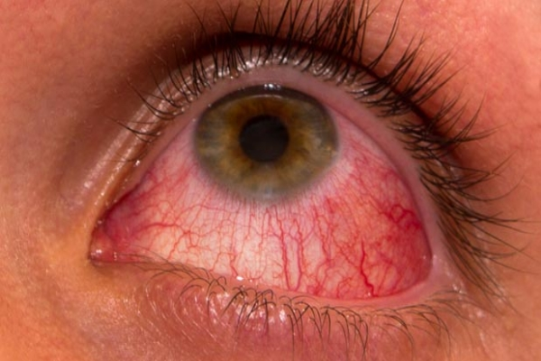
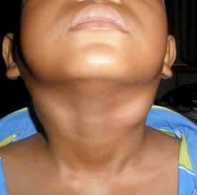
Lymphadenopathy
Conjunctivitis
Notes:
Maculopapular: Is derived from a fusion of two words, namely, ‘macules’ which is used to refer to small spots on the skin which are discolored and flattened in nature, and ‘papules’ which refers to small and raised bumps. Due to the abnormal redness of the skin due to capillary congestion that is a symptom of this disease
Coalesce: come together and form one mass or whole.
Lymphadenopathy: It is disease of the lymph nodes, in which they are abnormal in size, number, or consistency.
Conjunctivitis: also known as pink eye, is inflammation of the outermost layer of the white part of the eye and the inner surface of the eyelid. It makes the eye appear pink or reddish. There may also be pain, burning, scratchiness, or itchiness. The affected eye may have increased tears or be "stuck shut" in the morning.
Arthralgia: (from Greek arthro-, joint + -algos, pain) literally means joint pain; it is a symptom of injury, infection, illnesses
testalgia: Chronic testicular pain (CTP) is defined as uni- or bilateral, intermittent or continuous testicular discomfort
Orchitis: (or-KIE-tis) is an inflammation of one or both testicles.
Forchheimer spots: are small red spots on the soft palate in 20% of patients with rubella. They precede or accompany the skin rash of rubella. They are not diagnostic of rubella, as similar spots can be seen in measles and scarlet fever.
Prodrome is an early symptom (or set of symptoms) that might indicate the start of a disease before specific symptoms occur. It is derived from the Greek word prodromos, meaning "precursor".

Slide 19
Treatment and Management
There is no effective antiviral treatment for rubella. Treatment of symptoms includes plenty of fluids and pain relief if required.
Rubella spreads from person to person via droplets shed from the respiratory secretions of infected people. Rubella is contagious but less so than measles and chickenpox.
The best way to avoid catching rubella is to be immunized with the measles, mumps and rubella (MMR) vaccine
Rubella vaccine is a vaccine used to prevent rubella. Effectiveness begins about two weeks after a single dose and around 95% of people become immune.

Slide 20
Reason for selecting this microbe
As part of our course of study (Infectious Diseases) and considering its bar reputation of causing miscarriage between pregnant women, makes it good educational material to share and discuses it with other fellow students.

Slide 21
Motivator:
As students of Whitworth University, and part of Biology class 107, we are required to develop a PowerPoint presentation about a microbe that causes a specific human infectious disease. This PowerPoint is about Rubella which is also known as German measles.

Slide 22
Objective:
Provide follow students with class relative information about Rubella oregenized from reliable sources.

Slide 23
Agenda:
Welcome
Introduction
Microbial group
Name and origin
Interesting characters
Living environment
Disease and symptoms
Treatment and management
Reason for selecting this microbe

Slide 24
Whitworth University
Biology 107
Microbe Hunting on the World Wide Web

